Slide 1
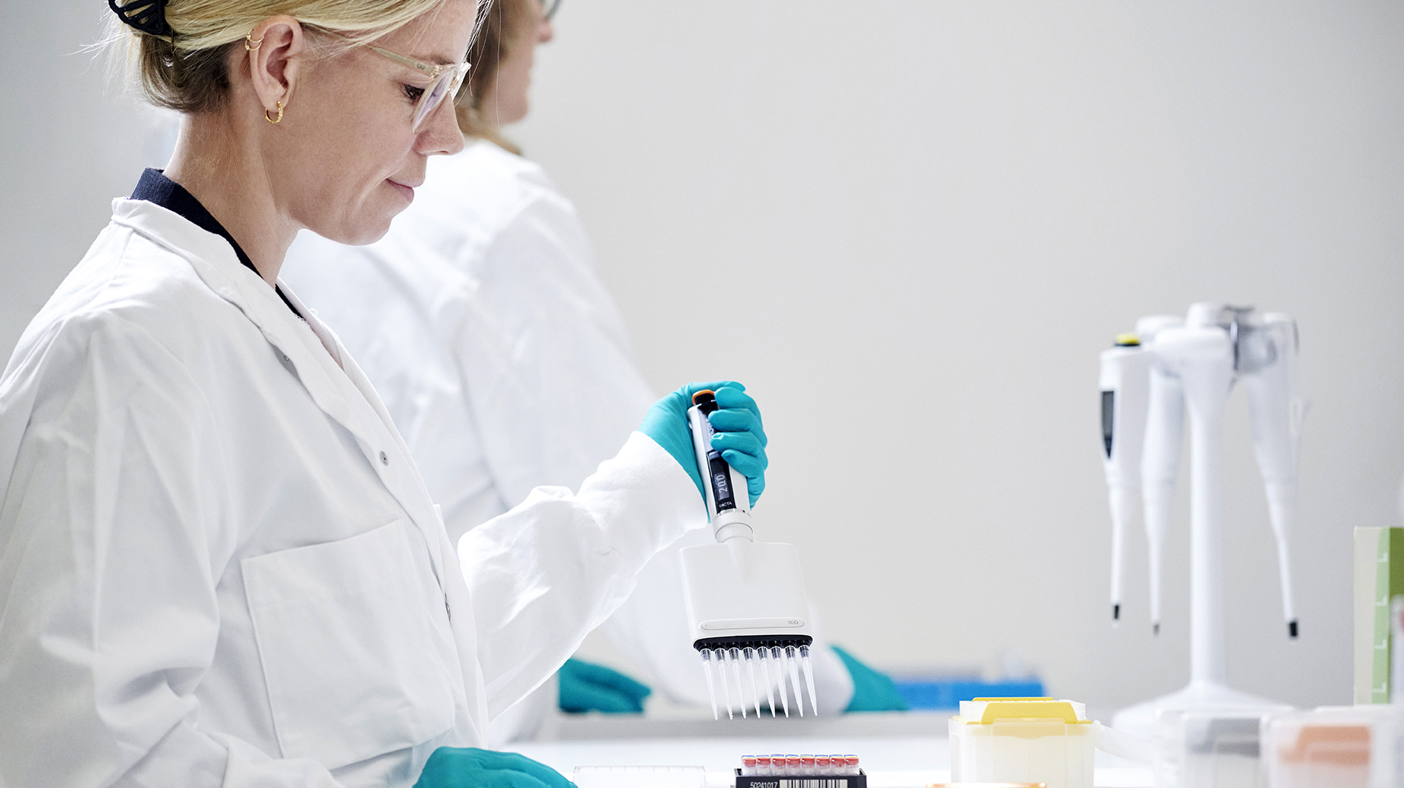

Investor presentation
Share ticker: Gubra l Nasdaq Copenhagen
May 2026

Slide 2
Forward looking statements
Matters discussed in this presentation may constitute forward-looking statements. Forward-looking statements are statements that are not historical facts and that can be identified by words such as “believe“, “expect“, “anticipate“, “intends“, “estimate“, “will“, “may“, “continue“, “should“, and similar expressions. The absence of these words, however, does not mean that the statements are not forward-looking.
The forward-looking statements in this presentation are based upon various assumptions, many of which are based, in turn, upon further assumptions. Although the company believes that these assumptions were reasonable when made, these assumptions are inherently subject to significant known and unknown risks, uncertainties, contingencies and other important factors which are difficult or impossible to predict and are beyond its control. Such risks, uncertainties, contingencies and other important factors could cause actual events to differ materially from the expectations expressed or implied in this release by such forward-looking statements. New risks and uncertainties may emerge from time to time, and it is not possible to predict all risks and uncertainties.
The information, opinions and forward-looking statements contained in this presentation speak only as at its date and are subject to change without notice.

Slide 3
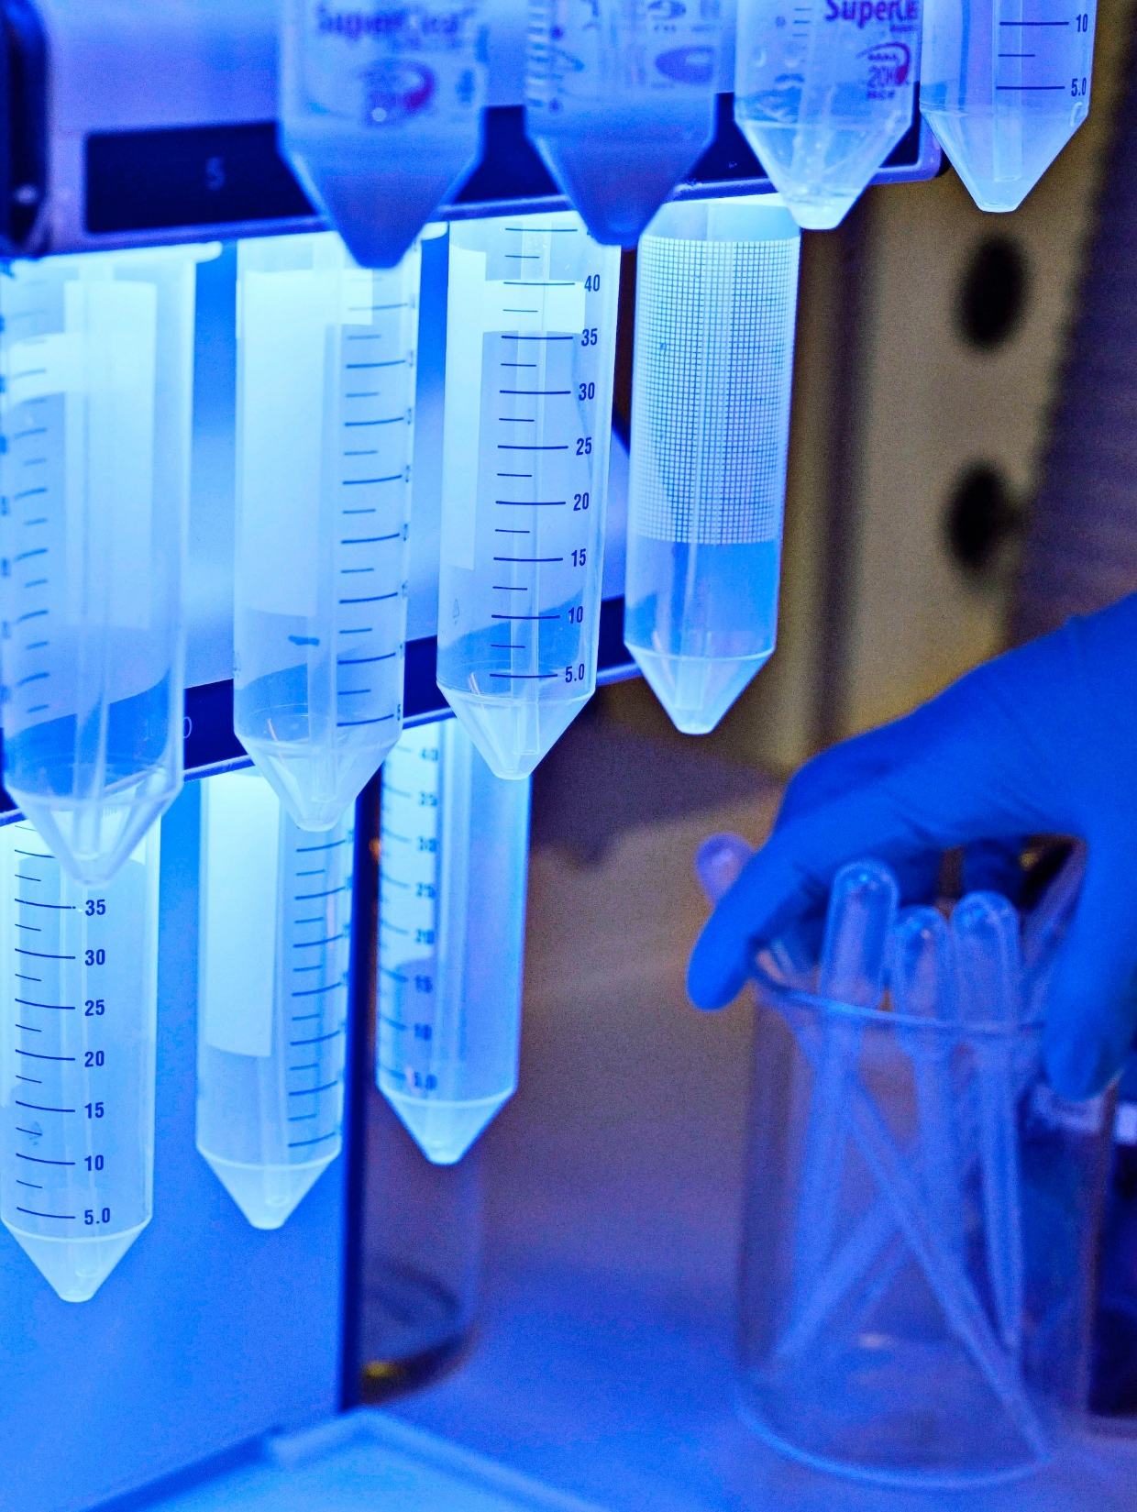
Gubra: A disease-agnostic techbio with deep peptide and preclinical expertise
OBESITY
>300
Gubra Biotech
Our value driver
Expertise
Employees
$400m
$325m
In revenue in 2025
(DKK 2.6bn)
In operating profit in 2025
(DKK 2.2bn)
Gubra CRO
Our value enabler
Gubra Ventures
Our value accelerator
Gubra Green
Our commitment to society
3

Slide 4
History and growth journey
2025 has been a record year for Gubra
Revenue
(USD million)

Slide 5
Recent events
Significant expansion of lab and office facilities at DTU Science Park and offices in Basel and Boston
Partner Amylyx selected AMX0318¹ as DDC for PBH and other rare diseases with IND targeted for 2027
CTA submitted for ambitious Phase 1/2a trial evaluating preliminary efficacy of GUB-UCN2
BI-partnered² triple GLP‑1/GIP/NPY2 agonist
BI 3034701 advancing to Phase 2 in mid‑2026
Facility expansion
Partnered program progressed
UCN2 CTA submission
BI 3034701 update
Clinical leadership strengthened
Gubra Ventures
launched
Gubra-discovered assets
BI 3034701 and ABBV-295 are advancing to Phase 2 in 2026
ABBV-295 Ph1 MAD
Appointment of CDMO Thomas Langenickel to strengthen clinical development capabilities
Launch of Gubra Ventures and appointment of Zoë Johnson to lead new venture creation unit
-9.8% vs -0.2% weight loss in 12 weeks MAD study, predominantly male participants with BMI <30
Notes: 1) AMX0318 is a long-acting glucagon-like peptide-1 (GLP-1) receptor antagonist; 2) BI 3034701 was developed in cooperation with Boehringer Ingelheim. Boehringer Ingelheim is solely responsible for its further development and global commercialization; DDC = Drug Development Candidate; PBH = post-bariatric hypoglycemia; CDMO = Chief Medical and Development Officer

Slide 6
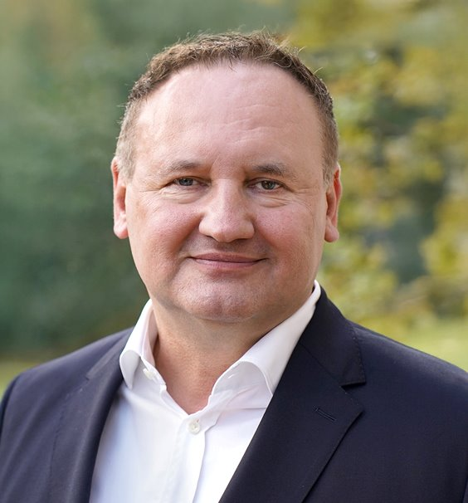





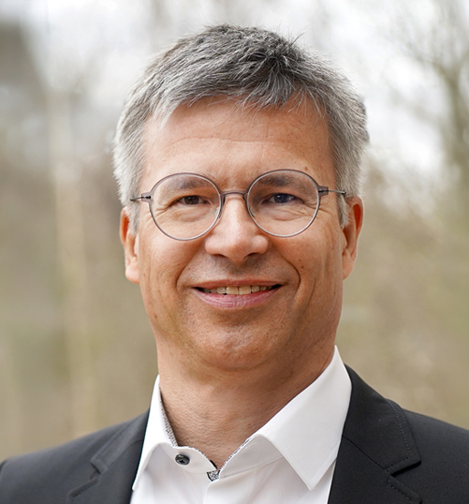
Our leadership team
Markus Rohrwild
Kristian Borbos
Trine Hamann
Louise S. Dalbøge
Chief Executive Officer
Chief Financial Officer
Head of CRO
Chief Science Officer
Zoë Johnson*
Gaurav Grigo
Thomas Langenickel
Head of Ventures & BD
Chief Technology Officer
Chief Medical and Development Officer
Notes: Zoë Johnson is legally associated with Gubra GmbH in Switzerland
6

Slide 7
Gubra business model:
Three business units create one integrated value creation model
One shared scientific core with three monetization engines...
...enables compounded value creation through
VALUE DRIVER
Core discovery and development unit, owning R&D and pipeline strategy
Gubra Biotech
Our value driver
Faster pipeline progression
VALUE ENABLER
VALUE ACCELERATOR
Broader and more resilient portfolio
Standalone commercial unit, operationally independent, but strategically integrated
Venture creation unit leveraging external capital
for pipeline optionality
Structured capital allocation and higher capital efficiency
Gubra CRO
Our value enabler
Gubra Ventures
Our value accelerator
Multiple monetization paths across time horizons
7

Slide 8

Where we play: From Discovery to high-value proof of concept clinical inflection
Value inflection magnitude
DISCOVERY
EARLY-STAGE DEVELOPMENT
LATE-STAGE DEVELOPMENT
Discovery and
hit generation
Lead optimization
Preclinical validation
IND-enabling preclinical development
Phase 1
Phase 2
Phase 3
Phase 1b/2a
GUBRA CRO
Provides foundational revenue stream
Clinical PoC
GUBRA BIOTECH
Drives growth through advancement of high-value assets
GUBRA VENTURES
Provides additional monetization pathways
Development candidate
IND
Safety and tolerability
Efficacy
Notes: PoC = Proof of Concept; IND = Investigational New Drug
8

Slide 9
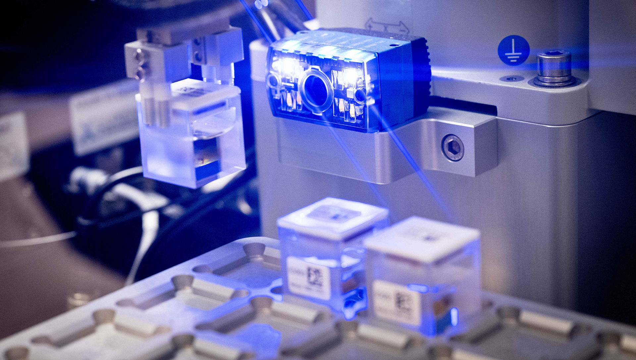
Gubra Biotech
Our value driver

Slide 10
Our AI-driven peptide discovery platform StreaMLine enables rapid identification of novel peptide candidates
Key advantages
AI-driven design combined with high-throughput wet lab screening
Hit to Development Candidate
< 1.5 years
High novelty and patentability of Development Candidates
Peptides optimized based on efficacy, Pharmacokinetics, selectivity, stability and solubility
Disease-agnostic, ready to scale into other high-growth disease areas
StreaMLine has delivered multiple assets with blockbuster potential
10

Slide 11
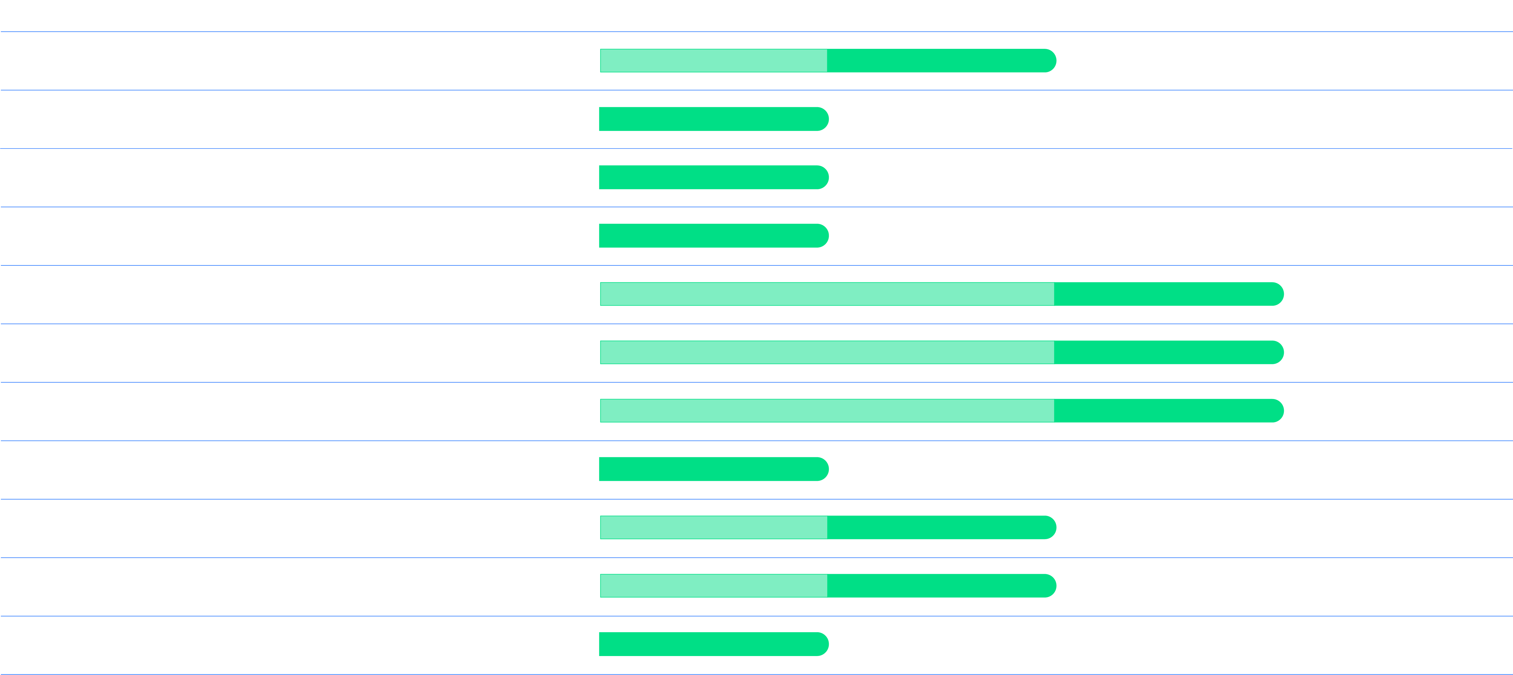
Strong progress across our early clinical pipeline, with multiple Phase 2 entries expected this year
CTA submitted for ambitious Phase 1/2a trial
ABBV-295 Ph1 MAD showed ~10% weight loss, expected to enter Phase 2 in Q3 2026
BI 3034701 to enter Phase 2 in the middle of 2026
Notes: UCN2 = urocortin-2; GLP-1 = glucagon-like peptide-1; PBH = Post-Bariatric Hypoglycemia; NPY2R = Neuropeptide Y Receptor Type 2

Slide 12
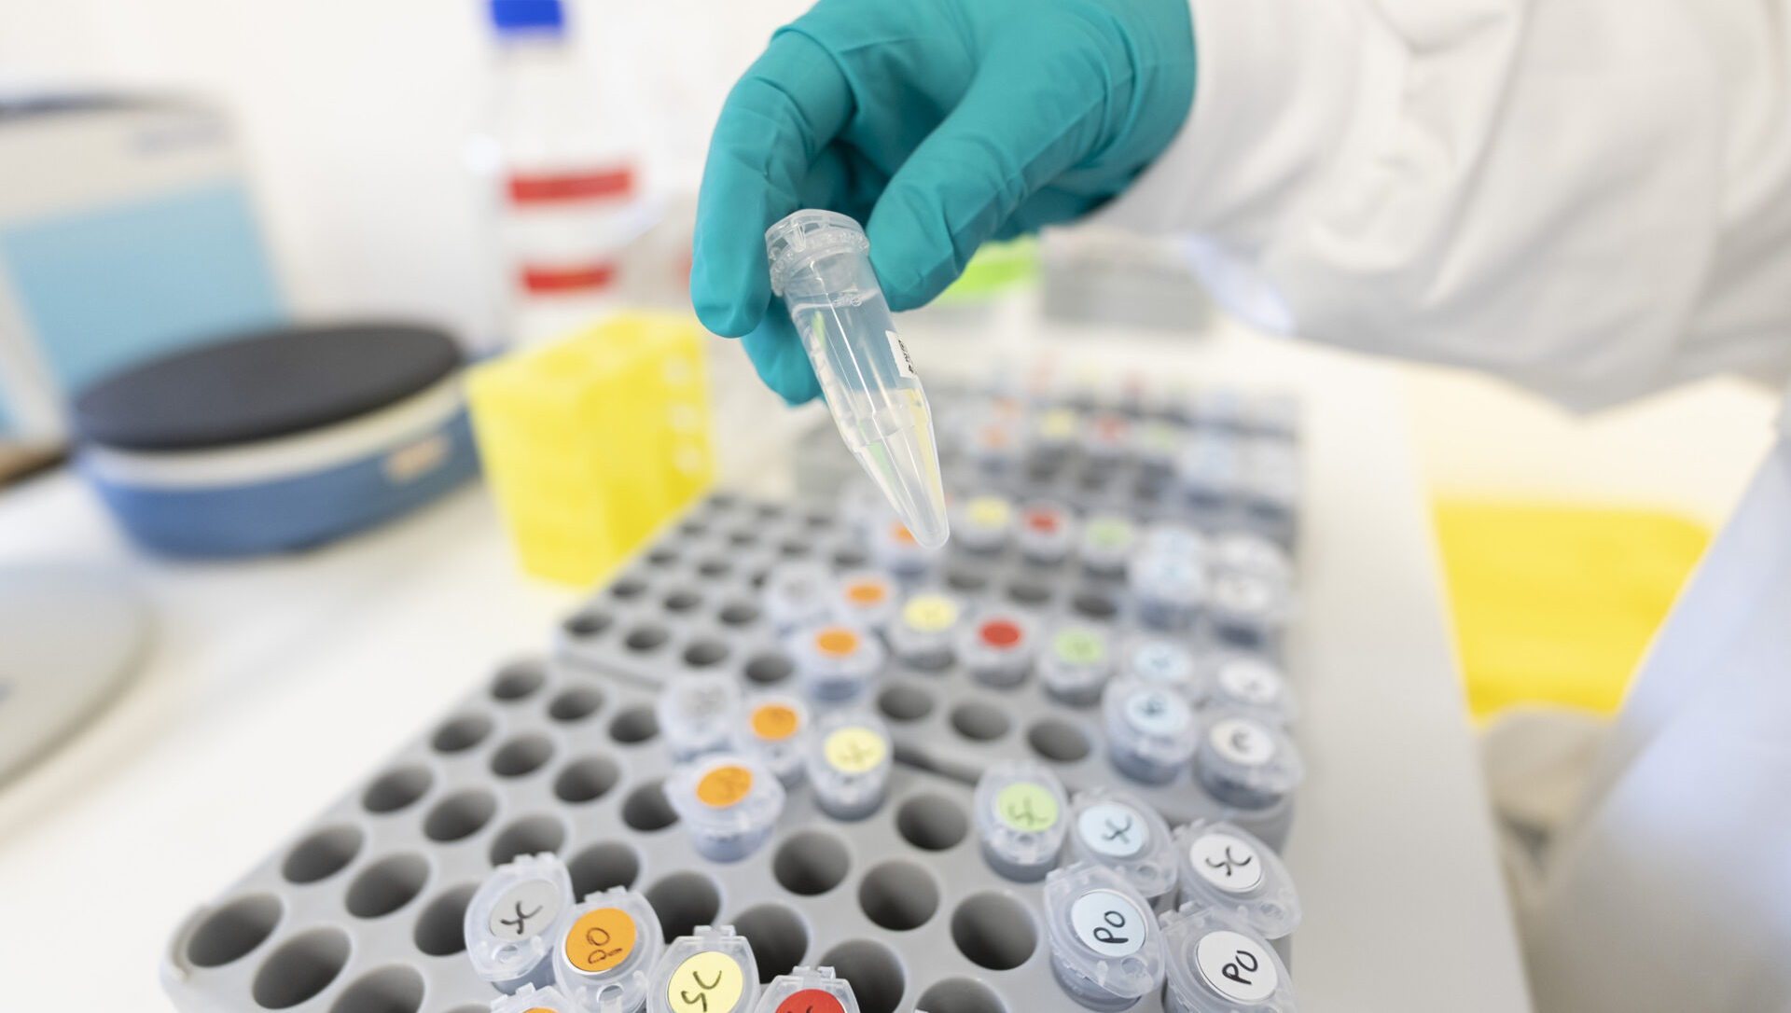
Obesity
Differentiation that matters

Slide 13
There is a paradigm shift in obesity treatment to focus increasingly on muscle‑preservation
Obesity continues to grow at a striking pace
However, there is a paradigm shift in treatment
Key trends will dominate
future treatment
Today, lean mass accounts
for 20-45% of weight lost¹
Obese and overweight people globally (bn)
Muscle-preserving
therapies²
Improved tolerability,
less side effects
More convenient dosing regimens
Combination therapies
Ability to address
co-morbidities
1) Sanchis-Gomar et al. Balancing weight and muscle loss in GLP1 receptor agonist therapy. Nature Reviews Endocrinology (2025).
2) Healthy or high-quality weight loss refers to a healthier, more sustainable form of weight reduction that prioritizes fat mass loss while preserving or even increasing lean muscle mass

Slide 14
Our deep peptide expertise has delivered 3 potential obesity blockbusters
LONG-ACTING AMYLIN ANALOG
TRIPLE AGONIST
UCN2
ABBV-295 out-licensed
BI 3034701 out-licensed*
GUB-UCN2 internal
Development stage:
Entering Phase 2 in Q3 2026
Development stage:
Entering Phase 2 in mid-2026
Development stage:
Entering Phase 1 H2’26
Long
half-life
Well
tolerated
Encouraging weight loss
Targeting 3 receptors
Encouraging weight loss
Favorable safety profile
Increases muscle and reduces fat
Improves cardiac function
Once-weekly s.c. dosing
Features of ABBV-295
Features of BI 3034701
Features of GUB-UCN2
Notes: *BI 3034701 was developed in cooperation with Boehringer Ingelheim. Boehringer Ingelheim is solely responsible for further development and global commercialization of BI 3034701; MAD = multiple-ascending dose; UCN2 = urocortin-2

Slide 15
Recent topline results for ABBV-295 demonstrate a competitive profile in the amylin class
LONG-ACTING AMYLIN ANALOG
Drug
ABBV-295
Competitive weight loss: Delivered up to –9.8%
at week 12 (weekly) vs. –0.3% for placebo.
Clear dose‑dependent response with good tolerability: Demonstrated dose‑dependent weight reduction across
2–14 mg with mostly mild GI symptoms.
Strong position as long‑acting amylin analog:
Achieved comparable weight loss with every‑other‑week
and monthly dosing after week 5.
Results in BMI<30 male dominant cohorts:
Study enrolled 88% male participants with BMI <30, normally associated with lower weight‑loss responsiveness.
Company
ABBV
1
Trial
Ph1 MAD
(Part 1)
Ph1 MAD
(Part 2a)
Ph1 MAD
(Part 2b)
Trial length
6 week
12 weeks
12-13 weeks
2
Female (%)
Not disclosed
12%
BMI
24 (for 2mg cohort)
<30
3
Dosing
1-2 mg
2-14 mg
4
Dosing frequency
Weekly
Weekly
Weekly/
Every-other-week/
Monthly
Weight
loss
2mg: -7.8%
PBO: +2.0%
Max: -9.8%
PBO: -0.3%
Max: -9.7%
PBO: -0.3%
NEXT STEPS
Ongoing US Phase 1b trial in obese patients (BMI 30-45); initiation of Phase 2 trial expected in Q3 2026
(AbbVie responsible)
Tolerability
Mostly mild gastrointestinal-related adverse events
15

Slide 16

Our landmark deal with AbbVie sets the stage for future partnering
LONG-ACTING AMYLIN ANALOG
$350m
$2.2bn
Upfront payment
Deal + royalties
-9.8% vs -0.2%
NEXT STEP
Weight loss in Ph1 MAD study
(BMI <30)
Multiple doses for 12 weeks
Ph1b US in obese patients
(BMI 30-45)
(AbbVie responsible)
Balanced
receptor profile
Long
half-life
Stability at neutral pH, potential for
co-formulation
Features of ABBV-295
16

Slide 17
Advancement of first-in-class triple agonist BI 3034701 validates our strength in scientific innovation and partnering
TRIPLE AGONIST
PROJECT
DISEASE AREA
PARTNER
DRUG DISCOVERY
PRE-CLINICAL
PHASE 1
PHASE 2
Triple agonist
Obesity
Boehringer
Ingelheim
Scientific innovation
Clinical progression
Investigational, potential first-in-class triple receptor agonist peptide for obesity
Targets three receptors GLP-1, GIP and NPY2 for enhanced efficacy
BI 3034701 to enter Phase 2 in the middle of 2026
Demonstrated favorable safety and tolerability profile
Showed encouraging weight loss in healthy and overweight/obese participants
BI 3034701* validates Gubra’s deep peptide expertise and strong partnering capabilities
Notes: *BI 3034701 was developed in cooperation with Boehringer Ingelheim. Boehringer Ingelheim is solely responsible for further development and global commercialization of BI 3034701

Slide 18
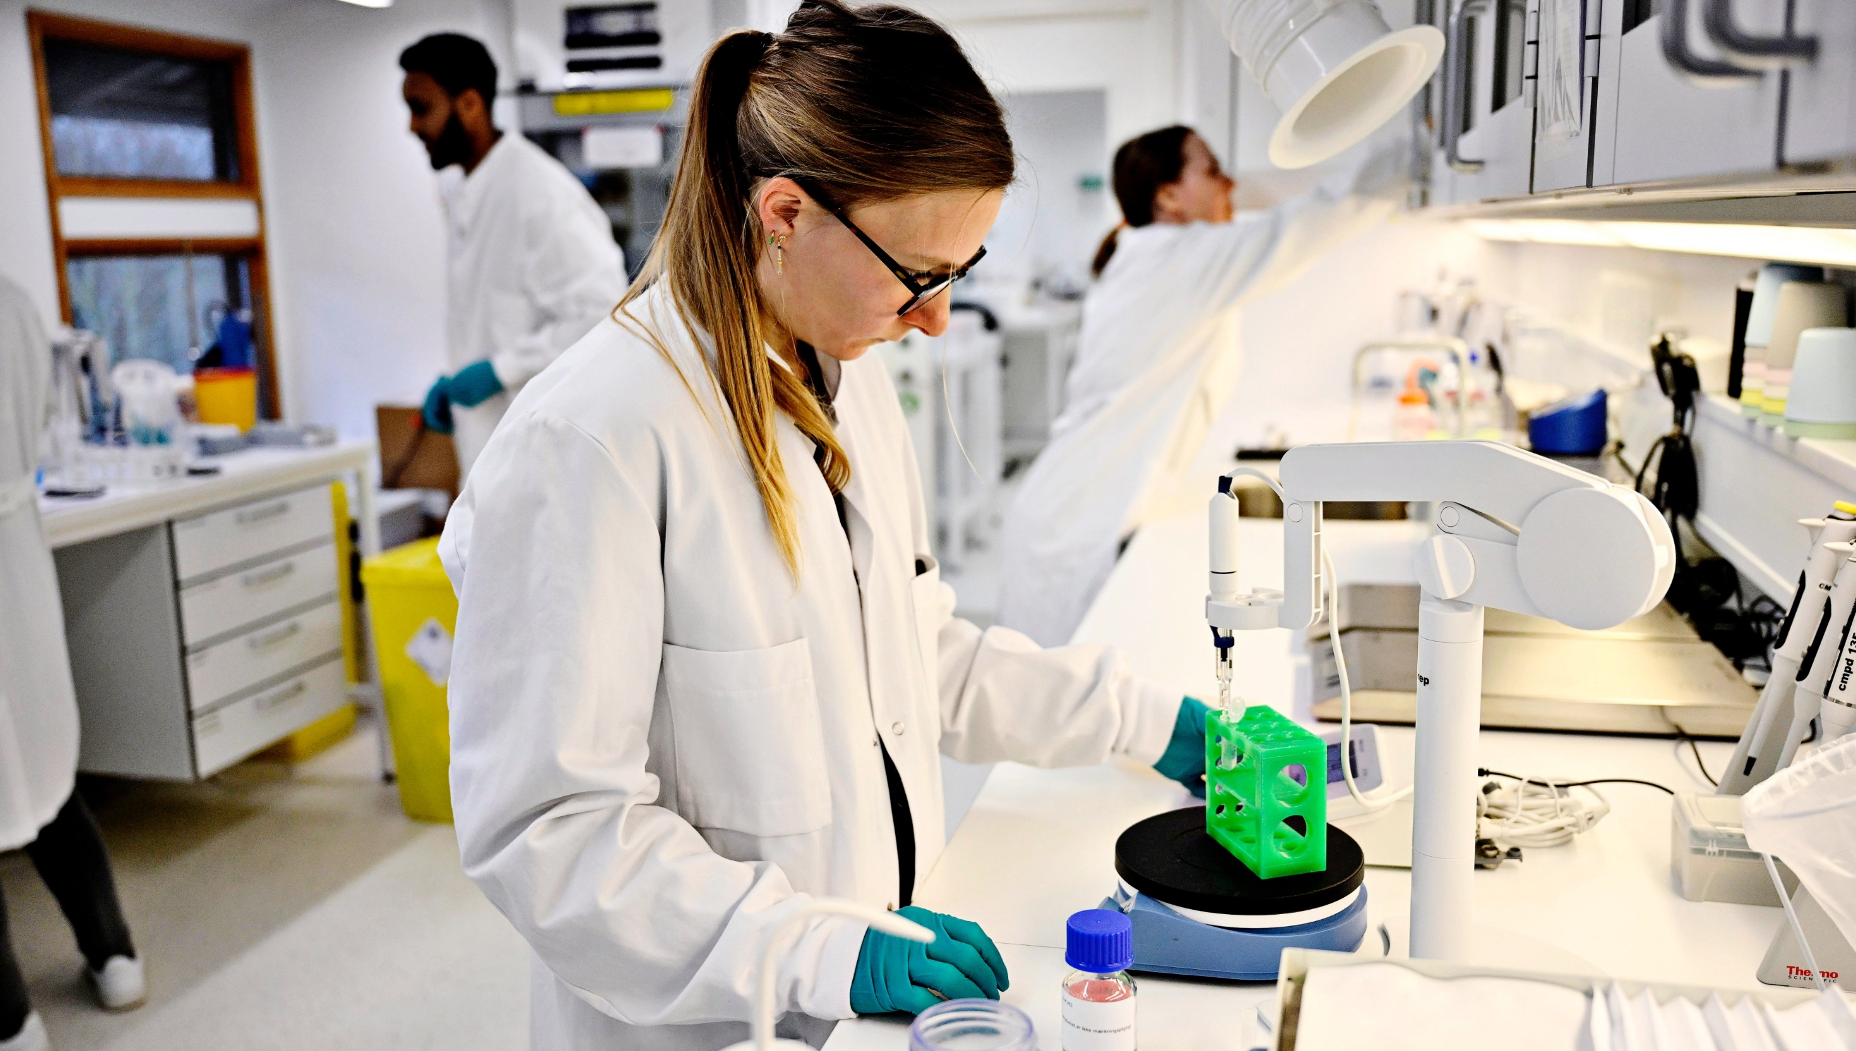
UCN2
GUB-UCN2
Gubra’s next mega-program focuses on muscle‑preservation

Slide 19
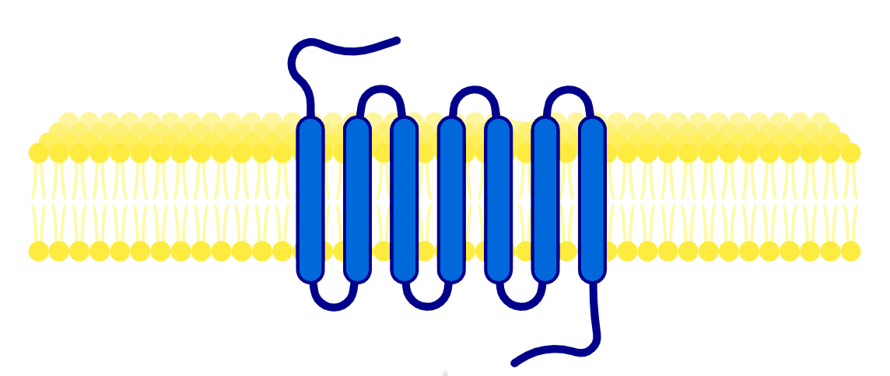

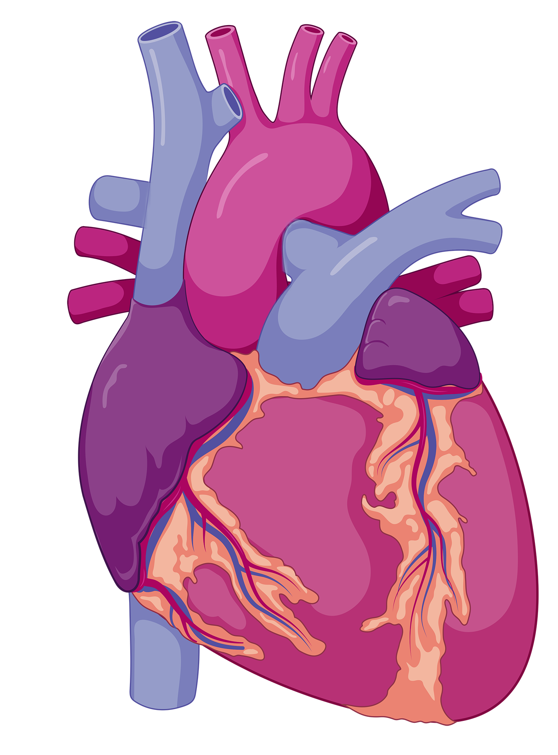
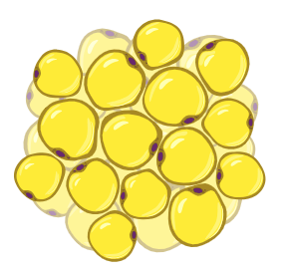
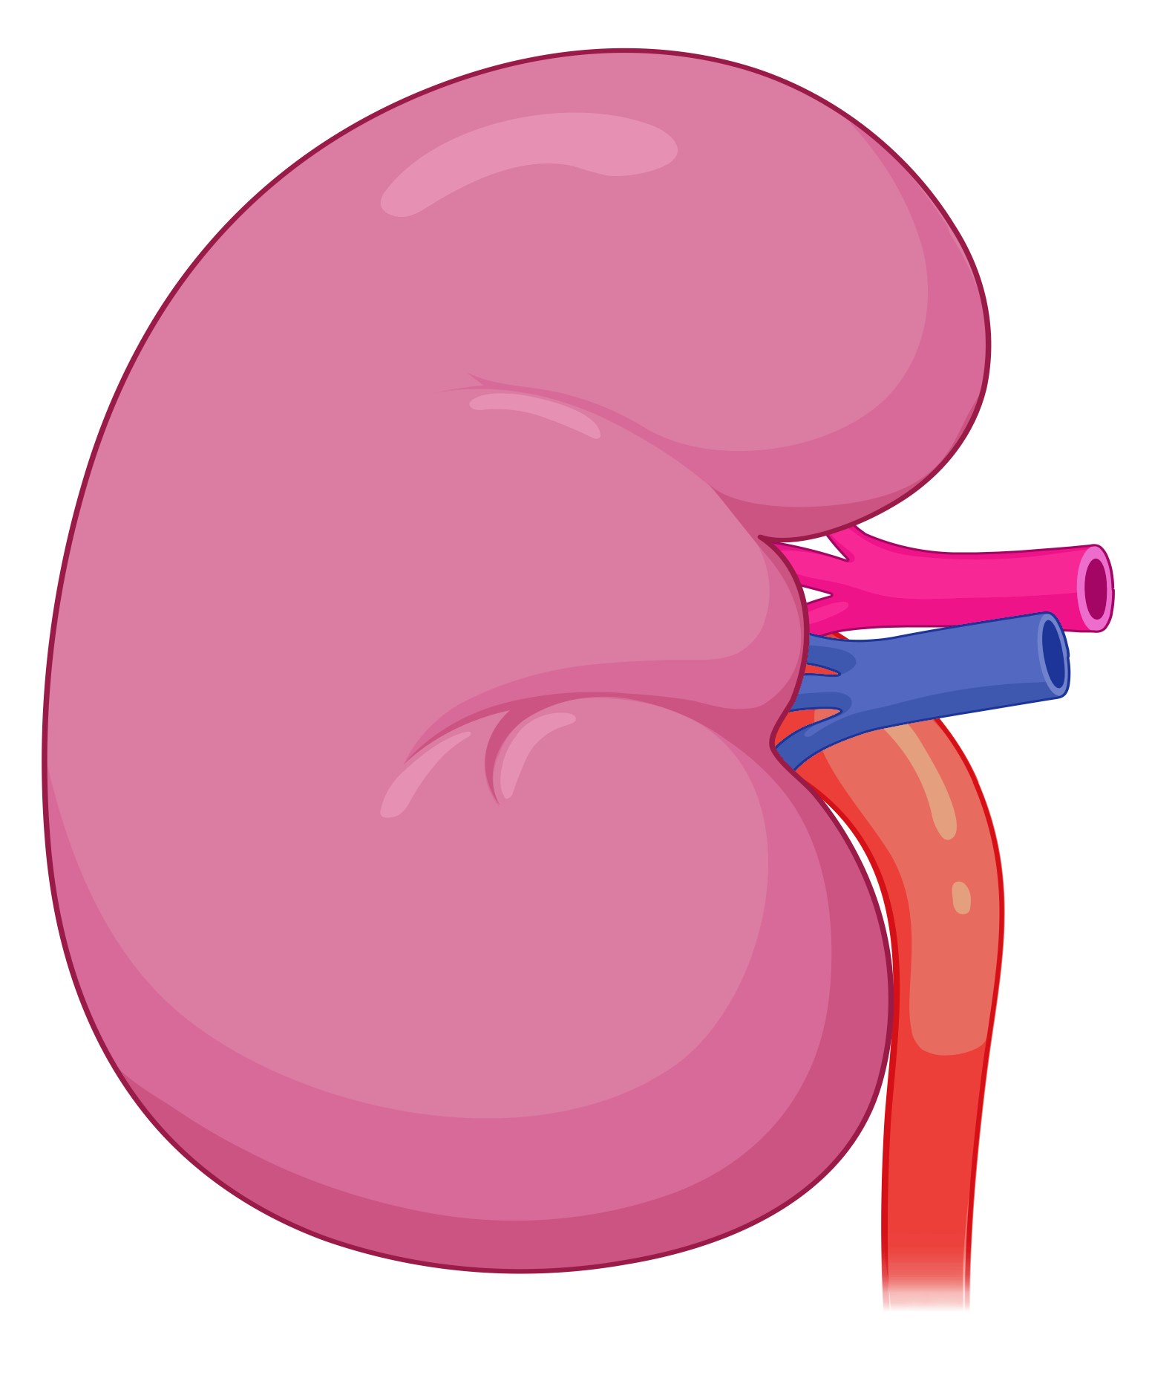
UCN2
Gubra’s next mega-program GUB-UCN2 has a novel mechanism of action that addresses key obesity trends
GUB-UCN2’S NOVEL MECHANISM HAS THE POTENTIAL TO ADDRESS METABOLIC AND CARDIORENAL INDICATIONS
UCN2
Key features of GUB-UCN2
38 aa neuropeptide
Highly potent and selective CHRH2 agonist
Excellent physical and chemical stability
Long-acting properties, supporting weekly dosing
Formulated for s.c. injection
CRHR2
Downstream Signalling
Adiposity
Muscle mass & function
Cardiac function
Renal function
Additive effect on fat mass loss, reducing plasma triglycerides
Increases muscle mass, restoring loss from anti-obesity drugs
Potential to improve cardiac function and CV outcomes in key patient groups
Potential to improve renal function and fibrotic remodeling in key patient groups
Note: UCN2 = urocortin-2; CRHR2 = Corticotropin-releasing hormone receptor 2; s.c. = subcutaneous
19

Slide 20
UCN2
GUB-UCN2 selectively decreases fat mass and restores semaglutide-induced lean mass loss
GUB-UCN2 increases fat mass loss while rescuing loss in lean mass in diet-induced obese rats co-treated with semaglutide
Fat mass
Lean mass
Body weight
GUB-UCN2 reduces fat mass, alone and in combination with semaglutide...
...while preserving lean mass and restoring semaglutide-induced lean mass loss
...resulting in improved body composition and maintained body weight reduction
30
30
20
10
0
20
***
-10
Body weight change (%)
Fat mass change (%)
*
Lean mass change (%)
***
-20
-30
***
10
-40
-50
***
-60
Week 12
0
Week 12
Week 12
Vehicle + Vehicle
GUB-UCN2 + Semaglutide
GUB-UCN2 + Vehicle
Semaglutide + Vehicle
Note: Values expressed as mean of n = 9-10 + SEM. Dunnett’s test one-factor linear model. *: P < 0.05, ***: P < 0.001 compared to Vehicle + Vehicle

Slide 21
UCN2
GUB-UCN2 eliminates lean mass loss and enhances fat mass loss induced by anti-obesity agents in DIO rats
GUB-UCN2 rescues lean mass loss and increases fat mass loss in obese rats in combination with an amylin (Cagrilintide), a GLP-1R agonist (Semaglutide) or a dual glucagon/GLP-1R agonist (Survodutide)
GUB-UCN2 maintains weight loss
with anti-obesity agents
GUB-UCN2 prevents lean mass loss caused by anti-obesity agents
GUB-UCN2 reduces fat mass, alone and in combination anti-obesity agenda
110
80
***
10
60
0
100
40
-10
20
-20
Relative body weight (%)
-30
Lean mass change from baseline (g)
Fat mass change from baseline (g)
0
-40
90
-20
***
***
***
-50
*
-40
-60
***
-60
***
-70
***
***
80
-80
-80
1
6
11
16
21
26
31
Study day
Vehicle
Cagrilintide
GUB-UCN2 + Cagrilintide
GUB-UCN2
Semaglutide
GUB-UCN2 + Semaglutide
Survodutide
GUB-UCN2 + Survodutide

Slide 22
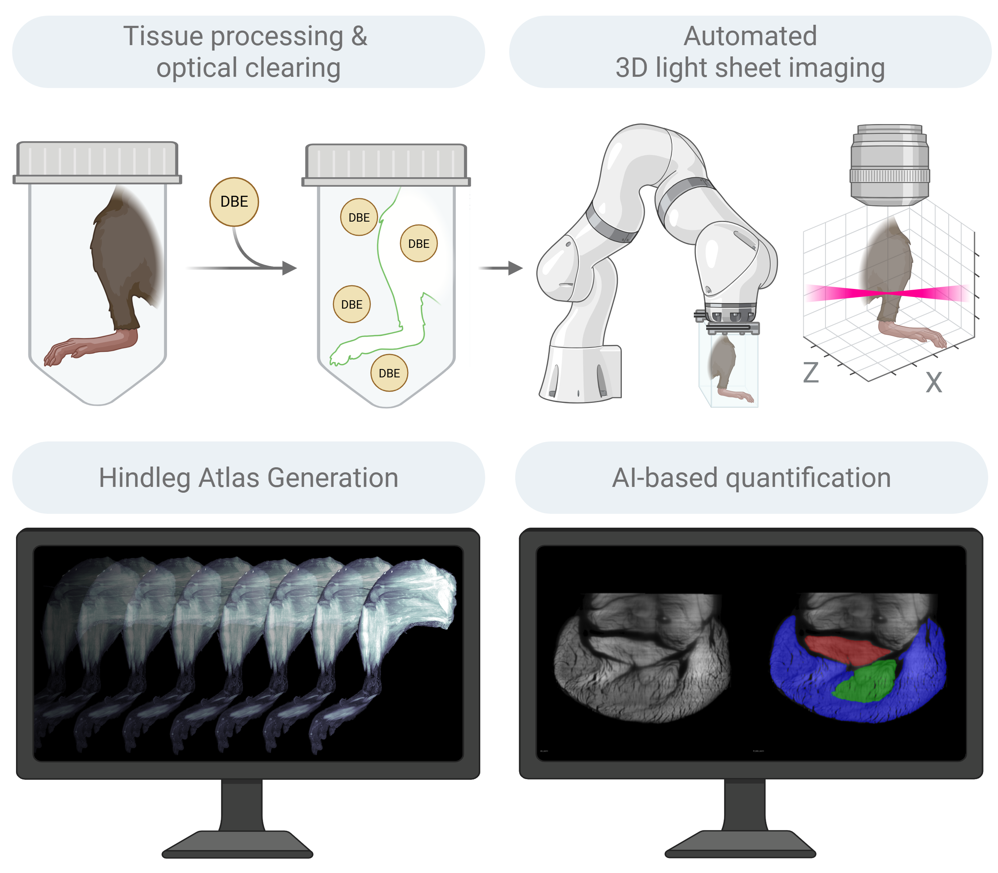
UCN2
Our advanced 3D imaging confirms direct beneficial UCN2-driven muscle growth
Gubra’s 3D imaging technology for skeletal muscle analysis
GUB-UCN2 increases total muscle volume in
hindleg from aged diet-induced obese rats both as monotherapy and in combination with semaglutide
Delivers high-resolution, quantitative tissue data using
AI and automation
Enables rapid, large-scale analysis of changes like muscle growth
Vehicle
GUB-UCN2
Semaglutide
GUB-UCN2
+Semaglutide
*: P < 0.05, **: P < 0.01 compared to Vehicle + Vehicle

Slide 23
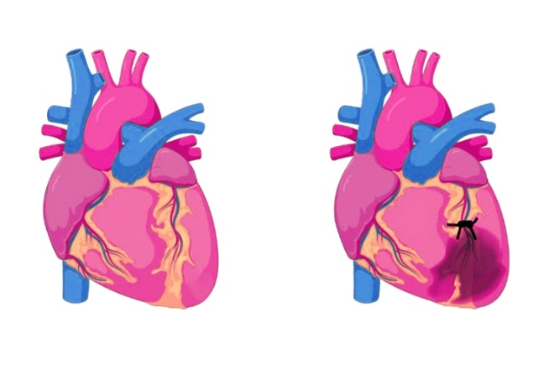
UCN2
In addition to improving body composition, UCN2 demonstrates clear cardiac benefits in preclinical models
Long-acting UCN2 significantly improves cardiac function in rats with myocardial infarction after 8 weeks of treatment
Rat model of Myocardial Infarction (MI)
UCN2 significantly improves cardiac output
Systolic function is improved
120
***
*
**
100
***
90
100
80
80
70
60
**
***
***
EF (M-mode, %)
Cardiac output (ml/min)
60
50
40
40
30
Left anterior
descending artery
Infarcted area
20
20
10
0
0
Sham-Vehicle
Vehicle
A+L+S
(SoC)
UCN2-low
UCN2-high
Sham-Vehicle
Vehicle
A+L+S
(SoC)
UCN2 low
UCN2 high
*: P < 0.05, **: P < 0.01,***: P < 0.001 compared to Vehicle; Treatment started 4 weeks after LAD ligation and continued for 8 weeks
A+L+S = atenolol+lisinopril+spironolactone; SoC = standard of care

Slide 24
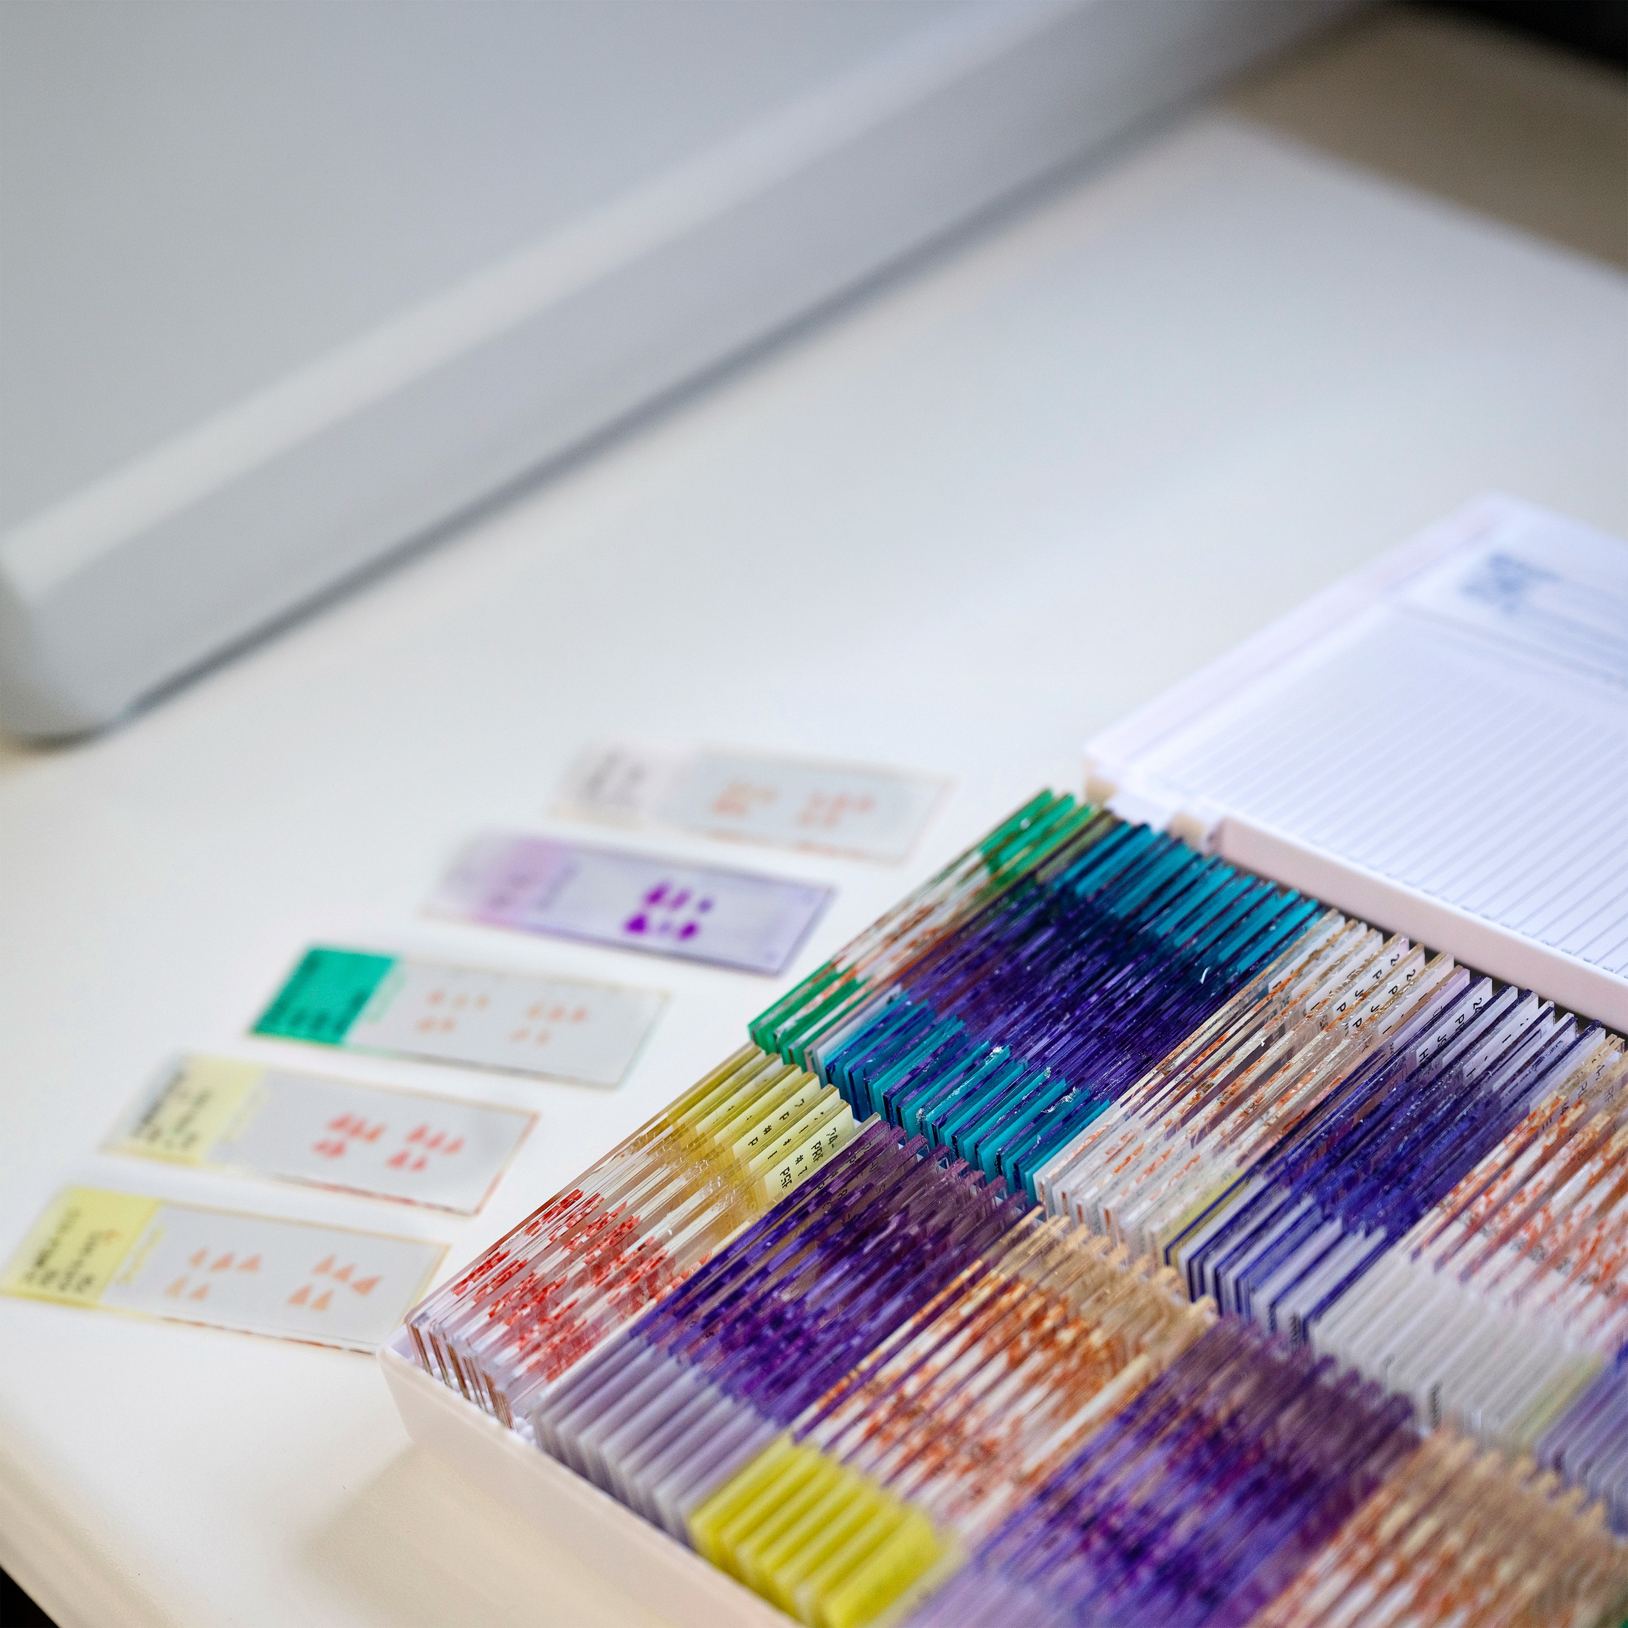
GUB-UCN2 will enter the clinic in H2 2026, setting the stage for broad indication expansion
UCN2
Our GUB-UCN2-focused R&D Day will
take place after FPFV, to enable a comprehensive discussion of the study design and development strategy
Key benefits
to validate in
the clinic
Primary
indication and
expansion
GUB-UCN2
product
Mechanism of action
Improved body composition
Primary indication
  Long acting Urocortin-2 (UCN2) peptide analog
  Highly selective Corticotropin-releasing hormone receptor 2 (CRHR2) agonist
  Increased muscle mass
  Decreased fat mass
  Obesity drug-induced muscle loss
Improved muscle function
Indication expansion opportunities
Dosing and logistics
  Improved strength and physical performance¹
  Leveraging cardiorenal benefits and favorable effects on metabolism and
  skeletal muscle
  SC injection, once weekly
Metabolism and comorbidities
  Improved insulin sensitivity and glucose homeostasis
  Improved cardiac output and renal function
Opportunity profile for GUB-UCN2
Sources: 1) Zierath et al. (2021) J Cachexia, Sarcopenia and Muscle; Isfort et al. (2003) Am J Physiol Endocrinol Metab; Kettelhut et al. (2022) Molecular Metabolism
24

Slide 25
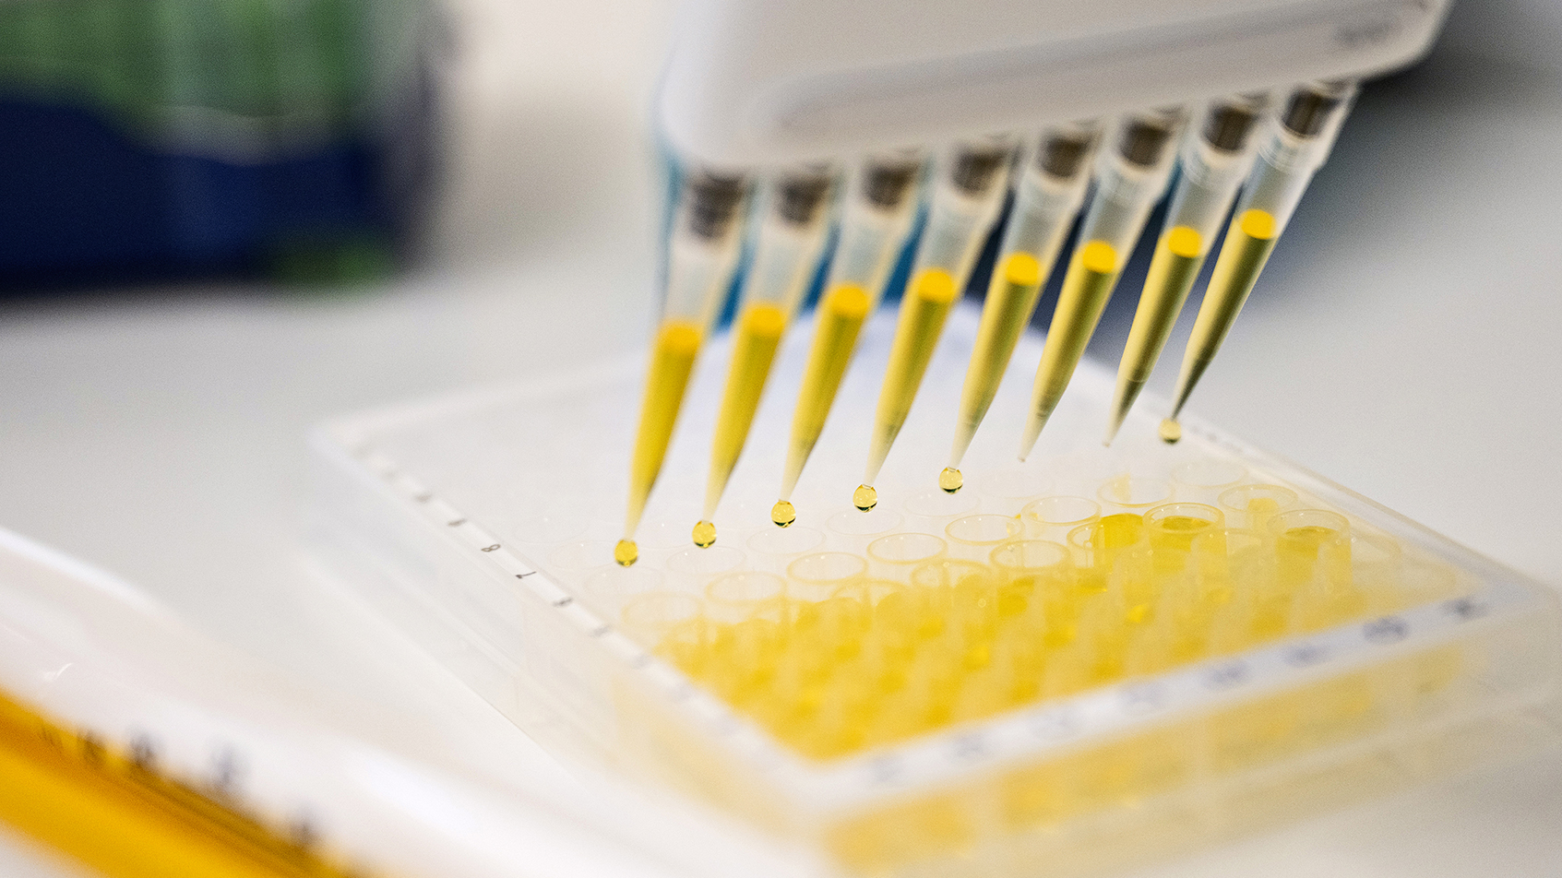
UCN2
GUB-UCN2:
CTA successfully submitted for Phase 1/2a trial
Ambitious First-In-Human Phase 1/2a trial enrolling ~188 participants
Evaluates safety, tolerability, pharmacokinetics, and preliminary efficacy
Focuses on muscle volume and muscle function endpoints
Investigates GUB-UCN2 as monotherapy and in combination with incretin
25

Slide 26
Gubra Ventures
Our value accelerator

Slide 27
Gubra Ventures will leverage external capital and our existing strengths for pipeline optionality
Strengthen innovation potential and providing more “shots on goal”
Enable exploration of new disease or technology areas beyond our current Biotech and CRO focus
Provide additional return on investment through future exits
Deepen market intelligence and shape where we play in collaboration with Gubra Biotech and Gubra CRO
Why Ventures?
Gubra Biotech
Our value driver
Ventures will build companies based on externally sourced assets to...
1
BD
M&A
2
Gubra Ventures
Our value accelerator
3
Gubra CRO
Our value enabler
4
27

Slide 28
Gubra is uniquely positioned to launch Ventures and will leverage our strong capabilities across Biotech and CRO
A maturing Gubra platform meets a changing innovation landscape and strong market opportunities
Moving beyond obesity
Technology edge
Market opportunity
Metabolic disease biology
Obesity expertise
Translational & clinical development
Peptide discovery
Optimisation platforms
Translational pharmacology
Leading metabolic market growth
Disease area expansion enabled by CRO, peptide, and platform expertise
Ventures will amplify existing strengths rather than dilute them

Slide 29
Venture risks must be balanced across scientific, technology, and clinical dimensions to balance portfolio risk
Scientific risk
Validated pathways
V1
V2
Novel biology
Technology risk
Proven formats
V2
V1
New modalities
Clinical risk
Clinical stage
V1
V2
Discovery / preclinical stage
Portfolio risk
Multi-company diversification
Concentrated exposure
Risk is managed at the portfolio level, not the individual venture level
Example ventures
Ventures portfolio
29

Slide 30

We will source external assets and create ventures that are lean and asset-centric by leveraging Gubra shared resources
Collaboration model between
Gubra Ventures, Biotech and CRO
Development functions
Clinical Development, CMC, Toxicology
Provides deep peptide expertise and AI-driven discovery platforms
Shapes core scientific strategy and direction
CRO
models
Biotech
StreaMLine
Ventures
Perceived by partners as key value enabler for Ventures
Staying close to core therapeutic areas will enable Ventures to leverage our CRO
Group
functions
HR, Digital, Finance
30

Slide 31
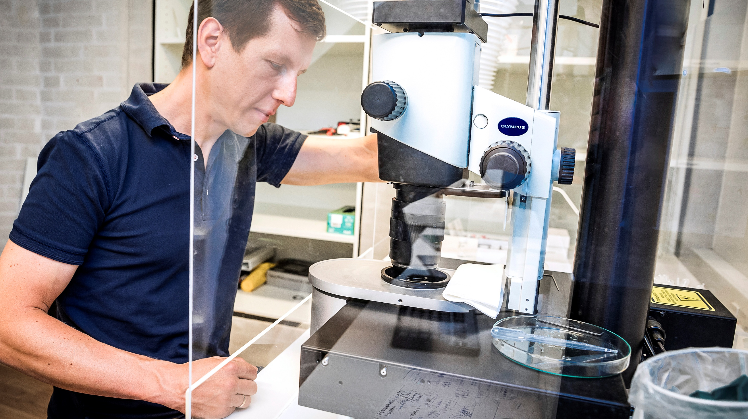
Gubra CRO
Our value enabler

Slide 32
Signs of improving market conditions and key future trends support our CRO growth ambition
CRO MARKET OUTLOOK
CRO EXPERT VIEW ON MARKET TRENDS
“What trends will define the CRO market over the next 3-5 years?”
Market recovering slower than expected but with signs of increasing demand
Increasing use of digital and AI/ML
%
Biotech funding stabilization supports activity, although longer decision cycles persist
Increasing growth in the CRO market
%
Increasing outsourcing by Pharma
%
Flat-to-low H1‘26 for CRO market with early signs of H2 recovery
Consolidation and specialization across players
%
Selected large pharma are showing more activity and engagement
Shifting global regulatory landscape
%
Sources: CRO Expert Survey (n=92), January 2026; Investor presentations, earnings calls,
broker reports, and financial reports of peers.
32

Slide 33

Our CRO business is Gubra’s foundation, specializing in high-growth markets since inception in 2008
Gubra serves
17/20
of the largest pharma
companies globally
New offering
New offering
14%
10-year organic revenue CAGR
Key technology focus
Notes: MASH = Metabolic Dysfunction-Associated Steatohepatitis; CKD = Chronic Kidney Disease; IPF = Idiopathic Pulmonary Fibrosis; CNS = Central Nervous System
Sources: MedWatch

Slide 34

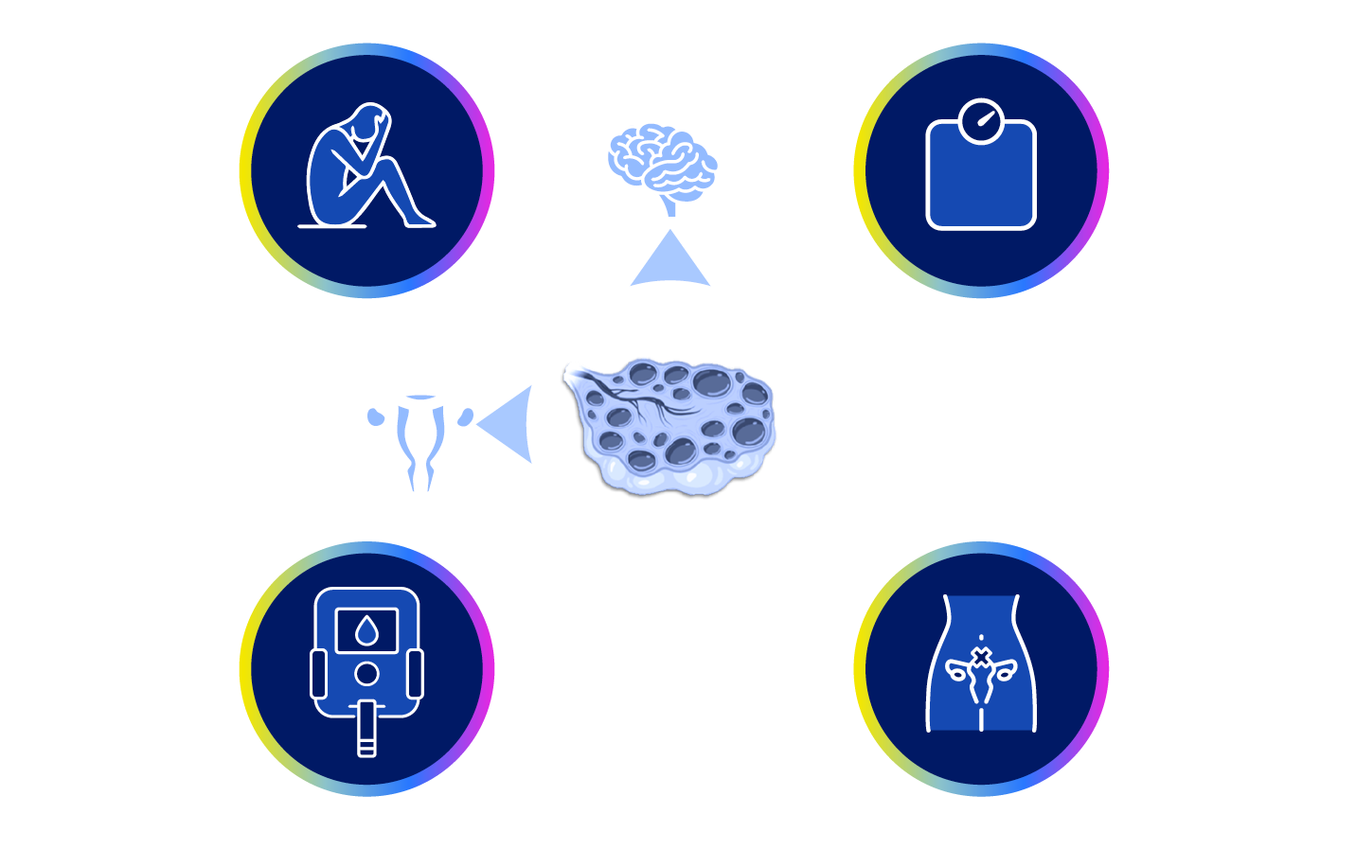
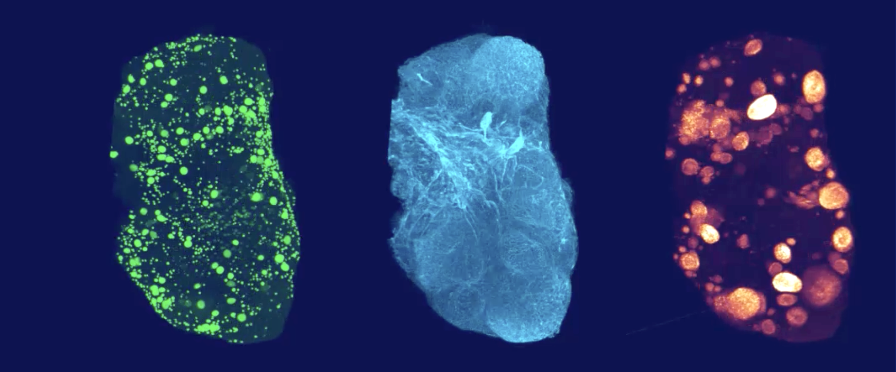
Polycystic Ovary Syndrome (PCOS)​
Gubra is driving innovation in
women’s health
Whole-ovary imaging
WHAT CAN GUBRA OFFER?
PCOS affects ~10% of women in reproductive age
PCOS has no cure and is managed by symptom relief including:​
Lifestyle changes​
Type 2 Diabetes medication​
Anti-androgens​
Gonadotropins/egg releasing hormones
Preclinical models
Complex animal models at scale with established in vivo for PCOS and POI.
Advanced imaging & analytics
Including 3D ovary imaging, estrous cycle evaluation, and detailed follicle staging.
PCOS & associated comorbidities:
Oocytes
AI-detected oocytes
Notes: PCOS = Polycystic Ovary Syndrome; POI = Primary Ovarian Insufficiency
34

Slide 35

Financial results
and outlook

Slide 36
BIOTECH BUSINESS
Q1 2026 financial results
Biotech revenue mDKK
Revenue
Revenue of DKK 28m compared to DKK 7m in
Q1 2025.
The increase was primarily due to milestone from Amylyx collaboration
Earnings
EBIT of DKK -39m compared to DKK -54m in
Q1 2025
The improvement was driven by higher revenue
Q1 2025
Q4 2025
Q1 2026
Biotech adjusted EBIT* mDKK
Q1 2025
Q4 2025
Q1 2026
* Adjusted for special items – No adjustments in 2026

Slide 37
CRO BUSINESS
Q1 2026 financial results
CRO revenue (organic). DKKm
Revenue
26% increase vs. Q4 2025, but slight decline vs. Q1 2025 (-6%)
Obesity continues to be the main growth driver
Macroeconomic uncertainty continues to affect smaller biotech clients
Earnings
EBIT improved from a loss in Q4 2025 to a small profit in Q1 2026
EBIT down vs. Q1 2025 due to lower revenue and large share of fixed costs
Q1 2025
Q4 2025
Q1 2026
CRO adjusted EBIT*. DKKm
CRO adjusted EBIT-margin*
21%
0%
Q1-2025
Q4-2025
Q1-2026
-14%
Q1-2025
Q4-2025
Q1-2026
* Adjusted for special items – No adjustments in 2026

Slide 38
Financial outlook and guidance
Key guidance items | 2026 outlook | Previous 2026 outlook | Mid-term guidance | Results 2025
Biotech Segment
Revenue | No guidance | No guidance |  | DKK 2,444m
Total costs¹ | DKK 330-360m | DKK 330-360m |  | DKK 251m
CRO Segment
External revenue | 0-10% growth | 5-15% growth | 10% annual growth | DKK 193m
EBIT-margin | 10-15% | 20-25% |  | 15%
Gubra Ventures EBIT | DKK -5 to -10m | DKK -5 to -10m |  | n/a
Gubra Green EBIT | DKK -5 to -10m | DKK -5 to -10m |  | DKK -1m
¹Total costs are cost of sales and operating costs
Comments to guidance:
In addition to performing CRO studies for external customers, the CRO business also performs studies for the Biotech business. This is not included in the outlook above
Studies for a total value of around DKK 50 million is expected to be performed for the Biotech unit

Slide 39
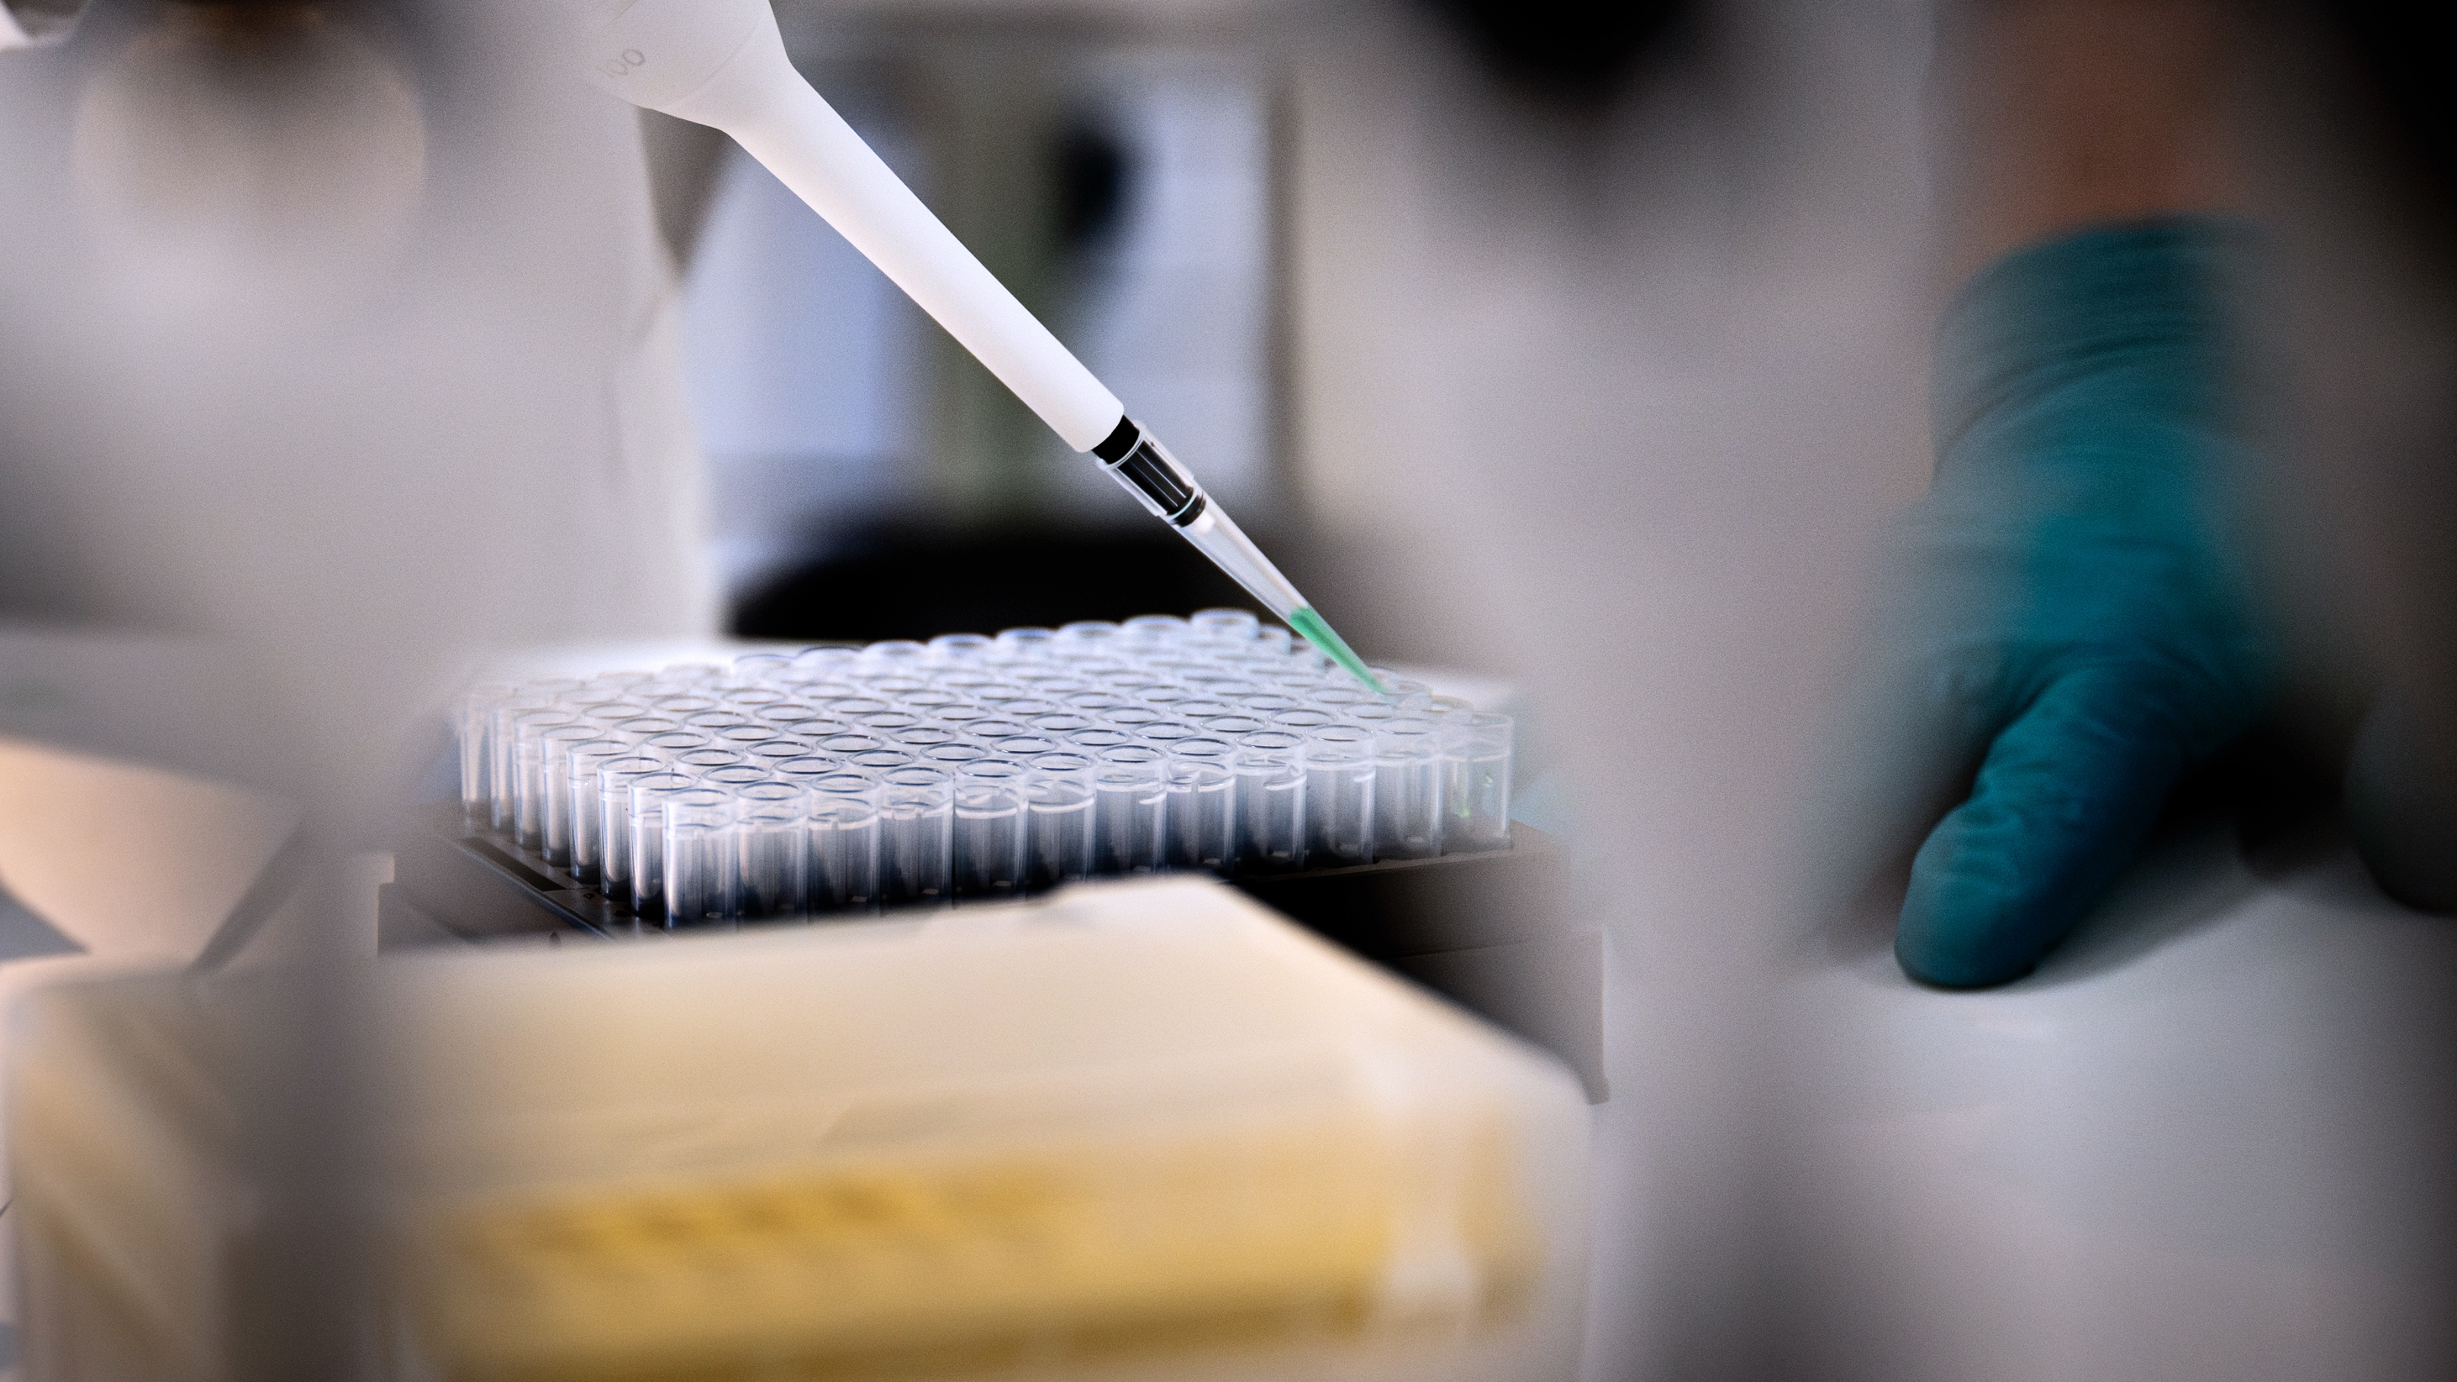
www.gubra.dk

Slide 40
Preclinically, GUB-UCN2 selectively decreases fat mass
while simultaneously protecting loss of lean mass
GUB-UCN2 increases fat mass loss while rescuing loss in lean mass in diet-induced obese rats co-treated with semaglutide
GUB-UCN2 has a neutral effect on body weight but improves body composition
GUB-UCN2 prevents lean mass loss and restores lean mass loss caused by semaglutide
GUB-UCN2 reduces fat mass, alone and in combination with semaglutide
120
25
20
20
10
110
15
0
10
-10
Body weight (%)
Lean mass change (%)
100
Fat mass change (%)
5
-20
90
0
-30
-5
-40
80
-10
-50
First
dose
1
2
3
4
5
6
7
8
9
10
11
12
First
dose
1
2
3
4
5
6
7
8
9
10
11
12
First
dose
1
2
3
4
5
6
7
8
9
10
11
12
Study week
Study week
Study Week
Vehicle + Vehicle
GUB-UCN2 + Semaglutide
GUB-UCN2 + Vehicle
Semaglutide + GUB-UCN2 (week 3)
Semaglutide + Vehicle

